Slide 1

GROCERY STORE MANAGEMENT🛒
By -
Mamta.Nagayya.Muppavarapu
Amrutha Sai.Yarragodala
T.Lakshmi Hari Chandana

Slide 2
About me
Why Data Science
Data Science is a fast-growing, high-demand field that turns raw data into meaningful insights, smarter decisions, and intelligent automation. For those who enjoy problem-solving, coding, and finding patterns, it provides a chance to build impactful, future-proof careers in a data-driven world.

Slide 3
Objective Of the Project
The objective of this project is to analyze, organize, and manage grocery store data efficiently, focusing on products, inventory levels, suppliers, sales, and customer transactions. By examining these elements, the project aims to identify patterns in product demand, sales performance, stock movement, and supplier reliability. This analysis helps users understand the real-world relationship between inventory management, customer buying behavior, and overall store performance.Through this system, we can observe trends such as which products sell the most, how frequently items need restocking, and which categories contribute the highest revenue. By examining metrics like stock-to-sales ratio, reorder levels, and daily sales volume, the study highlights fast-moving products, slow-moving inventory, and potential gaps in supply. These insights help improve inventory control, reduce wastage, enhance customer satisfaction, and support better decision-making for store management.

Slide 4
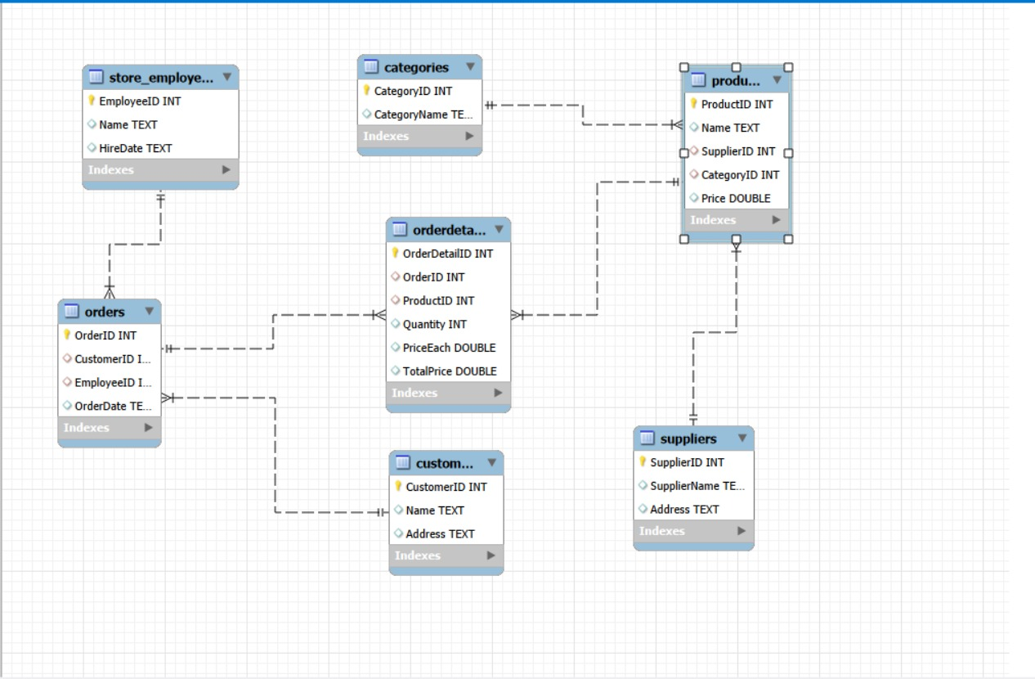
ER Diagram

Slide 5
About Schema
The GroceryDB database is designed to store and manage all information related to grocery items, sales, suppliers, and customers.
It contains six main tables:products holds details of each grocery item such as name, category, price, and stock level.suppliers stores supplier information, including supplier ID, name, and contact details.customers keeps customer details for billing and loyalty tracking.
sales records every sale transaction with product, customer, quantity, date, and total amount.
purchase_orders tracks items ordered from suppliers to restock inventory.
categories stores all product categories like fruits, vegetables, dairy, and grains.
All transactional tables like sales and purchase_orders reference products, customers, or suppliers to maintain consistency.
This relational structure helps in managing inventory, tracking sales, improving restocking decisions, and maintaining accurate supplier and customer information.

Slide 6
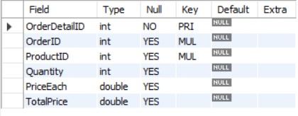
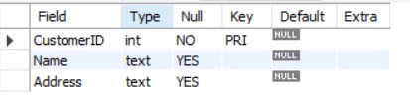

Tables
Order details
Customers
Categories

Slide 7
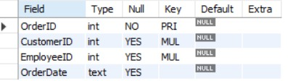
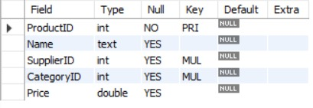
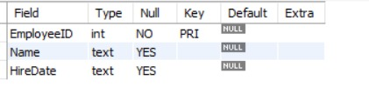
Orders
Products Table
Store employees Table

Slide 8

Suppliers

Slide 9


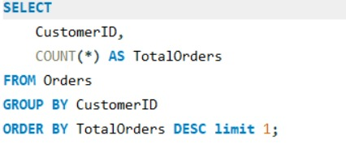

How many unique customers have placed orders
Which customers have placed the highest number of orders?

Slide 10
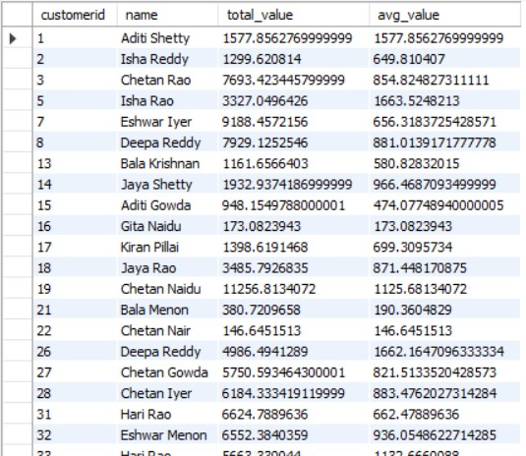
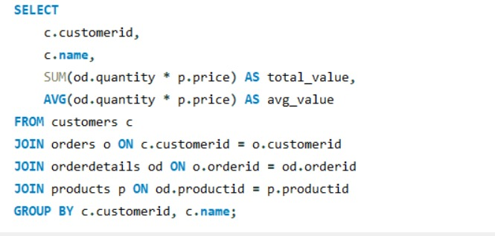
What is the total and average purchase value per customer?

Slide 11
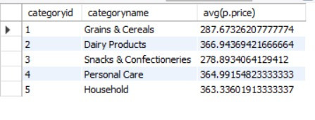
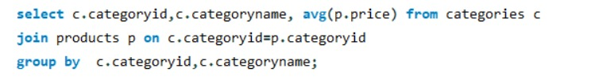
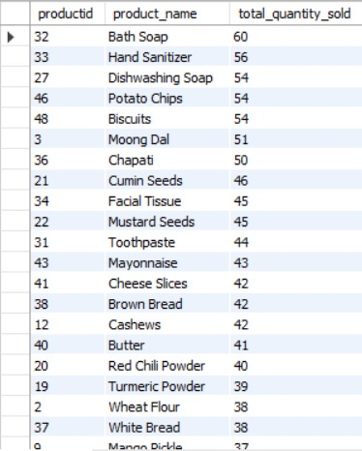
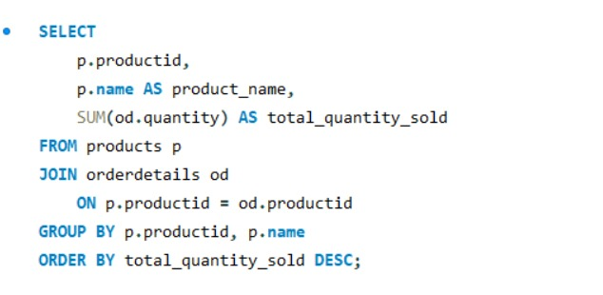
What is the average price of products by category
Which products have the highest total sales volume (by quantity)?

Slide 12
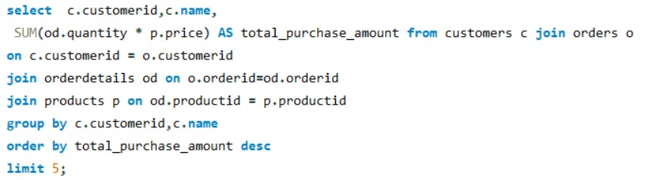
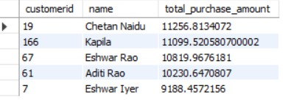
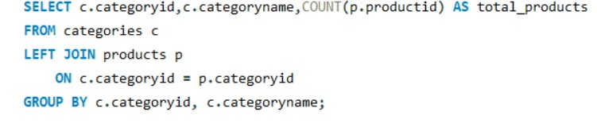
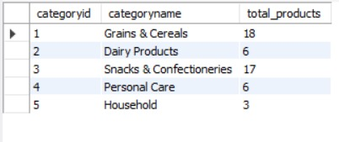
Who are the top 5 customers by total purchase amount?
Product Performance-- How many products exist in each category?

Slide 13
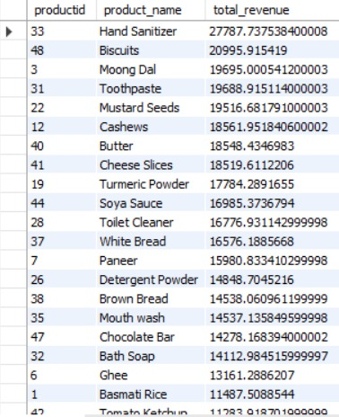
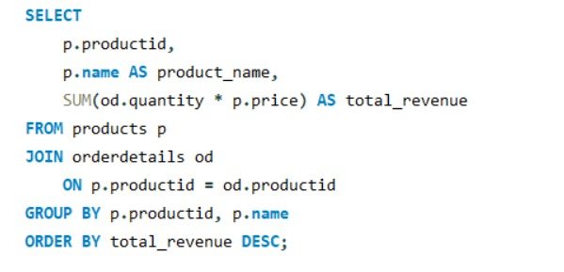
What is the total revenue generated by each product?

Slide 14
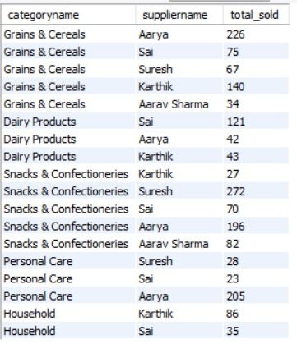
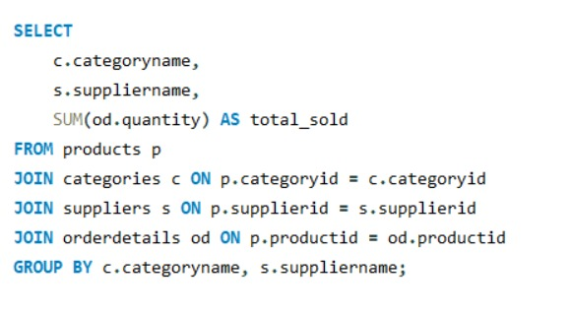
How do product sales vary by category and supplier?

Slide 15


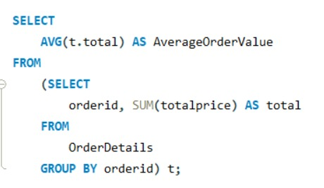

How many orders have been placed in total?
What is the average value per order?

Slide 16
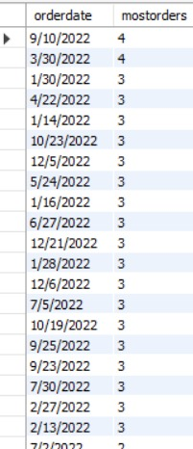
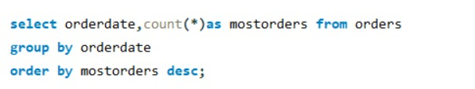
On which dates were the most orders placed?

Slide 17
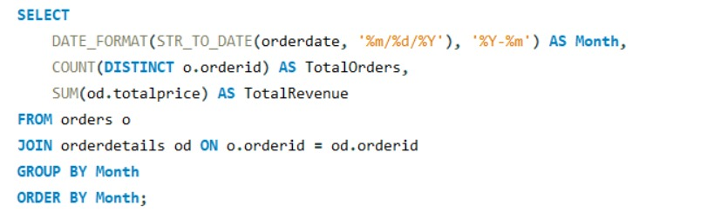
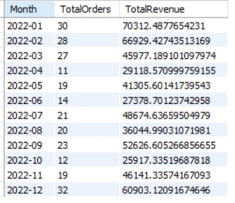
What are the monthly trends in order volume and revenue?

Slide 18
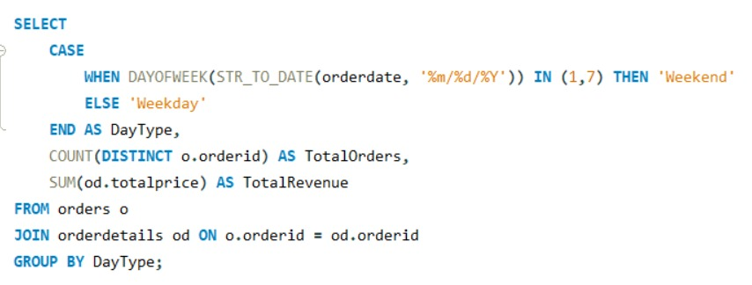
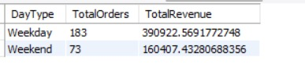


How do order patterns vary across weekdays and weekends?
4. Supplier Contribution
How many suppliers are there in the database?

Slide 19
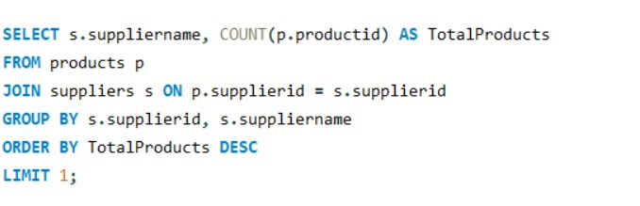

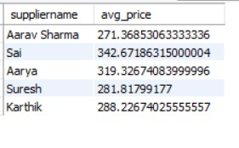

Which supplier provides the most products?
What is the average price of products from each supplier?

Slide 20
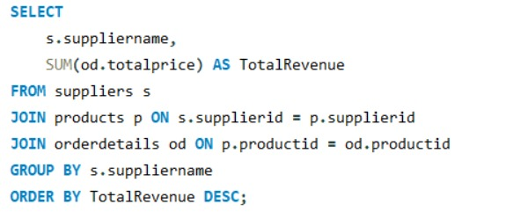
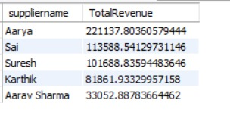

Which suppliers contribute the most to total product sales (by revenue)?
5. Employee Performance
How many employees have processed orders?

Slide 21
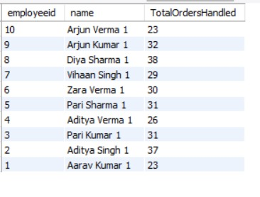
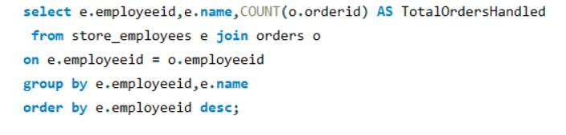
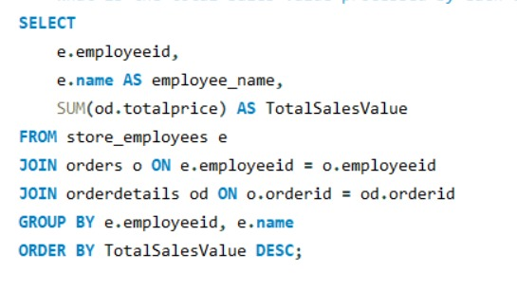
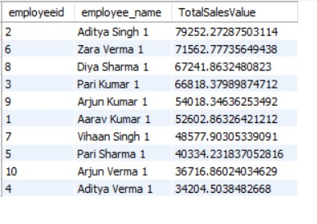
Which employees have handled the most orders?
What is the total sales value processed by each employee?

Slide 22
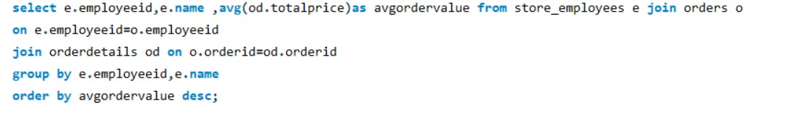
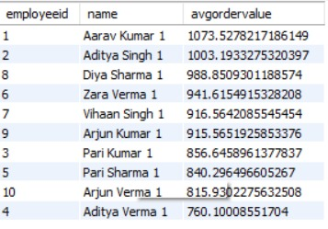
What is the average order value handled per employee?

Slide 23
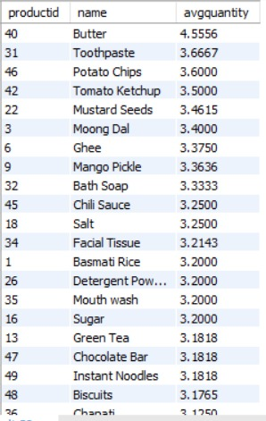
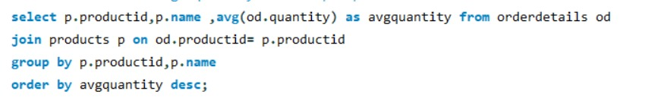
What is the average quantity ordered per product?

Slide 24
Final insights and recommendations
Keep more stock of fast-selling products and reduce items that don’t sell much.
Work closely with the suppliers who give the best products and bring in most sales.
Fix price differences by keeping product prices more stable.
Share work more evenly among employees so no one gets over loaded.
Give special offers or rewards to regular customers to keep them coming back.

Slide 25
Conclusion
Most sales come from a few loyal customers and popular products.
Only some suppliers provide the items that sell the most.
Employees handle different amounts of work, with a few doing most of the orders.
The store can improve by managing stock better, working closely with good suppliers, and rewarding regular customers.

Slide 26

THANK YOU

